Slide 1
RCSS Health and Wellness Guidelines

Slide 2
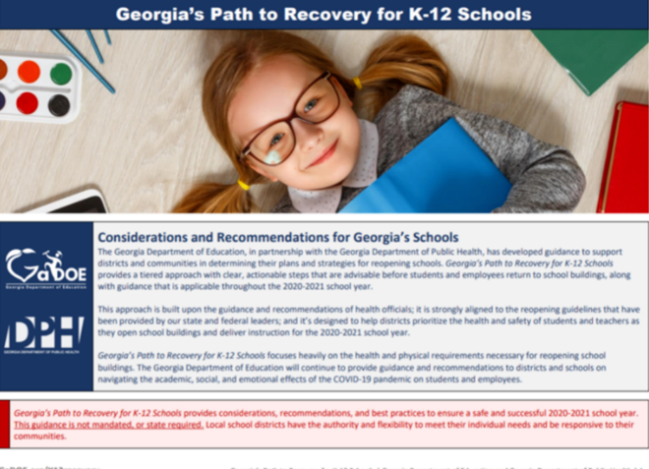
Collaborative Resources
Notes:
Hillman

Slide 3
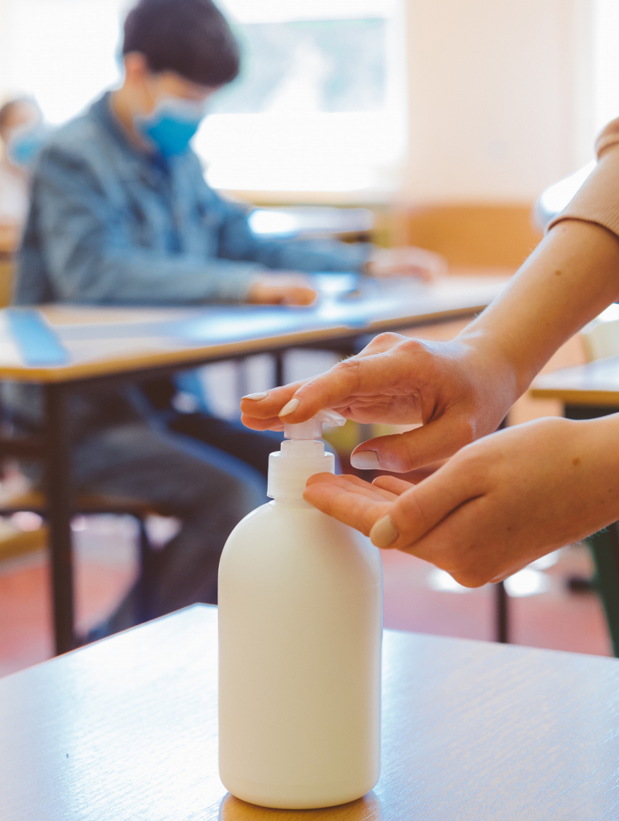
Areas of Consideration
District COVID-19 Hotlines and Crisis Team
School Nurse Clinic
COVID 19 – Point of Contact
Isolation Room
Best Practices
At Home Screenings- Students and Staff
Responding to Illness—Making Decisions
Decision Flow Charts
Letters
Attestation Form
Partial (Targeted) or Total Closures
Weekly Reporting to District and GADOE
Coping and Resilience
RCSS Health and Wellness Plan (Includes Advisement, Crisis Resources, and Community Resources)
Notes:
Hillman

Slide 4
COVID-19 Crisis Team and Hotline
We are aware that schools will need support and collaboration when the COVID-19 virus and situations centered around the virus appears in schools.
We have designed a team to support schools via RCSS COVID-19 Hotlines and continued daily communication. This team includes staff from the RCSS Human Resources Department and the RCSS Student Services Department.
Schools that have positive COVID-19 cases will contact members of this team immediately for reporting. District aggregate data will be sent to DPH daily (by 2:00p).
RCSS COVID-19 District Leaders
Dr. Cecil Clark Mr. Franklin Hudson Mrs. Gladys Hamilton Officer Jeff Tilley | Dr. Aronica Gloster Lead Nurse Annette Pollard Mrs. Shirley Godbee
Notes:
Hillman

Slide 5
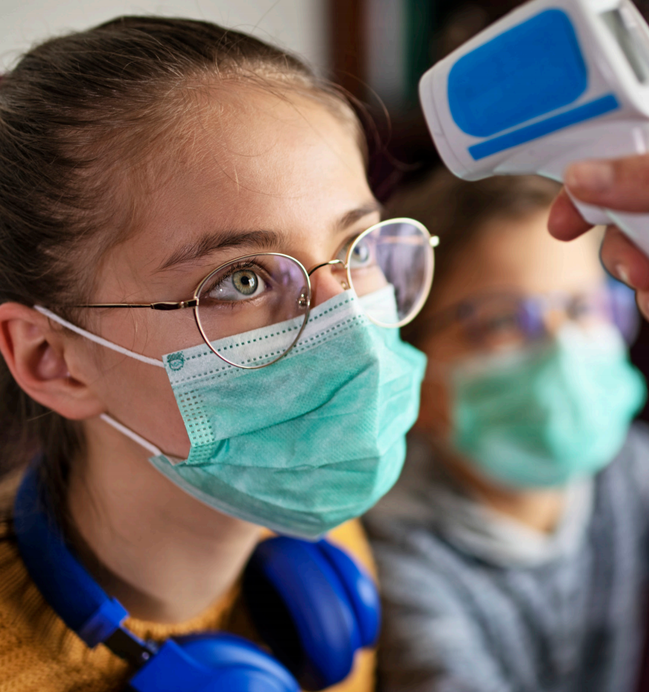
School Clinic
The clinic will remain open to address day-to-day medical needs, including medication administration (as always)
The clinic should always be stocked with soap and paper towels
PPE provided for school clinic (These should be in schools now)
Face shields
Masks
Gowns
Sneeze guards for desks
Hand sanitizer
Gloves
Infrared thermometer
Constant cleaning and disinfection (especially high touch items) should occur
Utilize markings on the floor to help people maintain a distance of 6 feet apart
Please ensure social distancing in the clinic area

Slide 6
COVID-19 Point of Contact (POC)
Schools Need a Designee, along with Nurse
Responsibilities:
Interviewing staff and students who have symptoms
Addressing questions related to COVID-19
Reporting positive cases and contact tracing lists to the principal and district COVID-19 Crisis Team.
Reporting to the GADOE weekly
Along with nurse, keeps a log of students, staff, quarantine dates, return to school dates. Log identifies those who:
Did not attend school due to COVID- 19-related illness OR
Were sent home due to displaying COVID-19 symptoms OR
Tested positive
Supervising the school Isolation Room
Notes:
AG

Slide 7
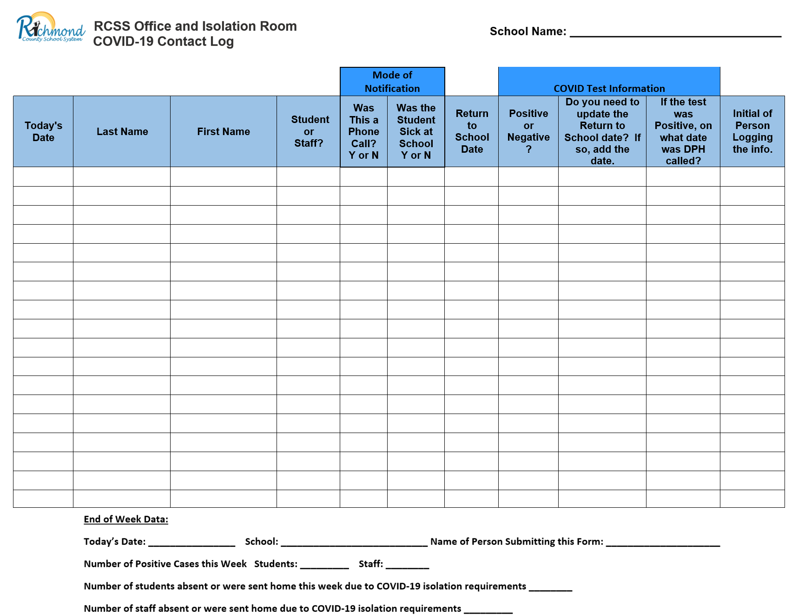
COVID-19 Contact Log

Slide 8
Isolation Room
Purpose: To separate persons exhibiting symptoms of the COVID-19 virus from others to reduce chance of spread
Separate room near the clinic
Ensure students seeking medical care (i.e. asthma management or wound care) are kept separate from students being isolated with COVID-19 like symptoms
Door with window (recommended)
Good ventilation; outside door or windows recommended
Ideally – should have a sink and bathroom
Dividers to split room for several students/staff (Recommended)
Be prepared to possibly hold children for long periods of time
Constant cleaning and disinfection
PPE available and used strictly
Supervisory personnel will be trained (POC)
Notes:
AG

Slide 9
Procedure for Assigning Students/Staff to the Isolation Room
Step 1:
The Nurse/POC, teacher or other adult will wear PPE to go pick up or escort the child from classroom * Please do not send the ill student to the office alone.
Step 2:
Ensure ill student has on a mask before leaving the classroom. Other students in the class may also put on masks.
Step 3:
Upon arrival to the Isolation Room, the Nurse/POC will log the student into the COVID-19 Notebook.
Step 4:
The Nurse/POC will interview the student to determine symptoms. The Nurse/POC will also take the student’s temperature with the touch-free thermometer. *Dial 911 if student/staff is in distress.
Step 5:
The Nurse/POC will call the parent/guardian to pick the student up from school.
Ensure ill staff/students are not left unsupervised.
Step 6:
The sick students should remain in the supervised Isolation Room until parent/Guardian arrives. *If the parent does not arrive within the hour, please be sure to call emergency contacts found in Infinite Campus. If no one comes to the school before the school day ends, please ensure everything has been done to contact parents and emergency contacts before calling School Safety and/or DFACS. *Never put sick students on the bus.
Notes:
AG

Slide 10
Best Practice: Seating Charts and Cohorting
Seating Charts
Teachers will be required to take the roll everyday and to design seating charts. Teachers will require students to sit in the same seat each day. This will help with contact tracing if needed. * Note: Roll should be recorded beginning with first day of school to support possible contact tracing.
Cohorting
Please ensure students and staff groupings are as static as possible by having the same group of students stay with the same staff (all day for young children, and as much as possible for older children).
Notes:
AG

Slide 11
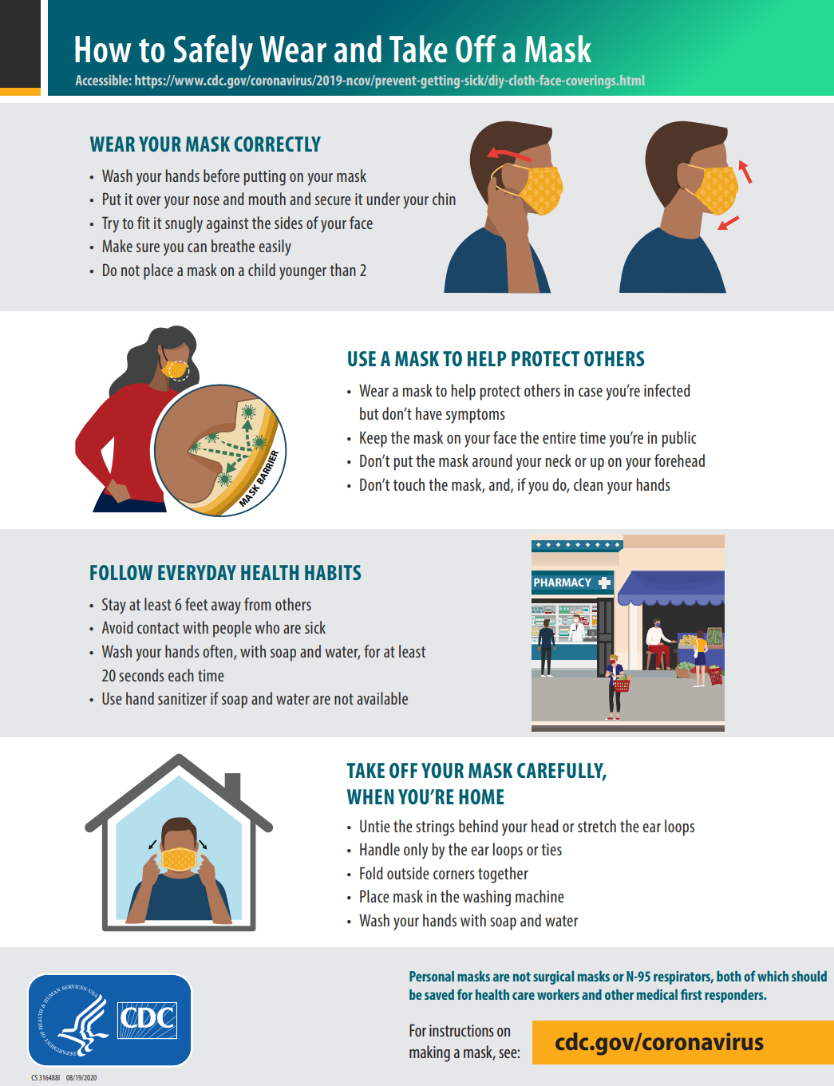
COVID Best Practice: Use of Masks
Masks are required on buses and in open spaces and hallways (areas where social distancing not possible).
Masks are highly recommended in all
areas
Required in clinics, isolation rooms, areas that
are occupied by sick students/staff
Visitors must wear masks
Maintain disposable masks at school
Advisement sessions on
“How to properly wear a mask” (Lesson plans
will be provided by Student Services Dept.)
Notes:
Pollard

Slide 12
COVID Best Practice: Social Distancing
https://youtu.be/nOa8wIhQdzo
Decreasing class sizes.
Providing age-appropriate visual and verbal reminders to staff and students to stay 6 feet away from each other. ▪
Placing barriers such as plexiglass at reception desks.
Arranging desks 6 feet apart.
Designating hallways, exits and entry doors to be one-way to reduce the likelihood of staff and students meeting face to face.
Discontinuing activities in which large groups of people are together such as cafeteria dining, assemblies, field trips and having multiple classes out for recess in the same time and place. Some activities such as assemblies and field trips could be done virtually from classrooms.
Notes:
Pollard

Slide 13
COVID Best Practice: Hand Washing
https://youtu.be/fpXh2XHwMmE
Notes:
Pollard

Slide 14
At Home Screenings
Students: Screened daily at home by parents
Provide parents screening tool
Students who are symptomatic (fever, cough, etc.) not to come to school
Staff: Screened daily at home prior to coming to work
Provide staff screening tool
Staff members who are symptomatic (fever, cough, etc.) not to come to work but will contact administrator and POC. (Discussions about sick leave will occur with the administrator and RCSS HR Dept.)
*At School
Each school nurse and POC will keep a daily log of teachers, staff, and students who:
Did not attend school due to COVID- 19-related illness OR
Were sent home due to displaying COVID-19 symptoms.
Notes:
Hillman

Slide 15
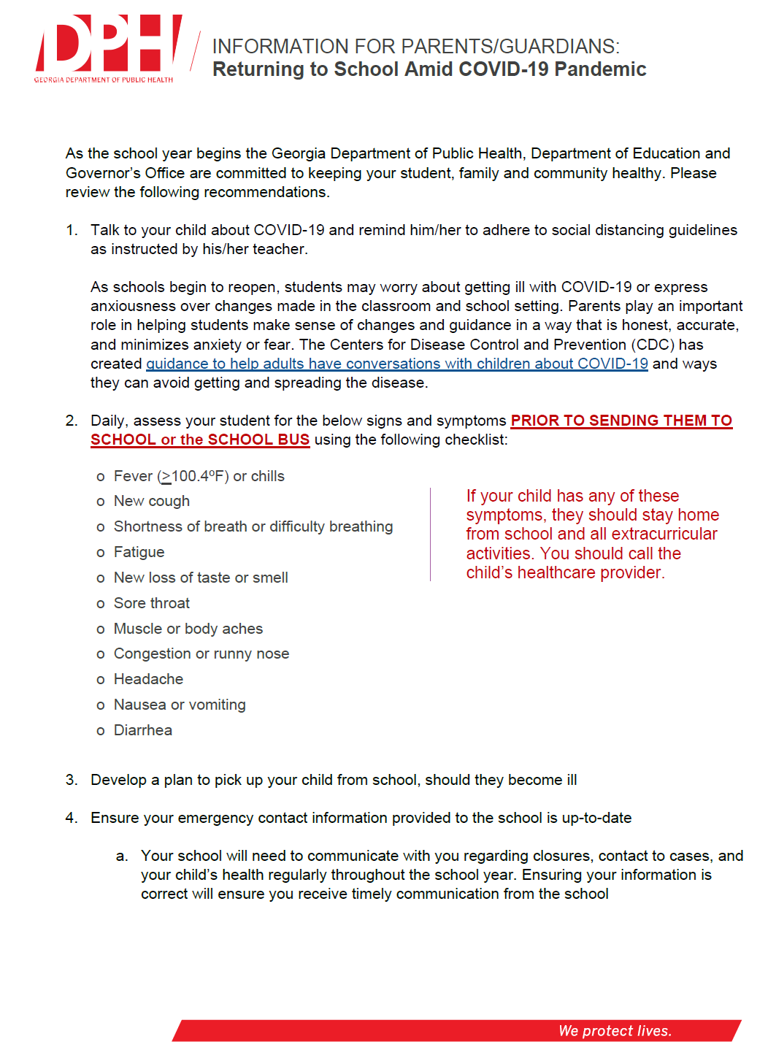
At Home Screenings
*Please be sure parents update all IC contact information. This is particularly important this year. Make this a talking point at Open House
Notes:
Hillman

Slide 16
Making Decisions: Flow Charts
Responding to Illness and Potential Exposure The following scenarios may require isolation and communication to parents:
Scenario 1: Symptomatic student with COVID-like symptoms
Scenario 2: Asymptomatic student is exposed to a confirmed COVID-19 positive person
Scenario 3: Symptomatic student is exposed to a confirmed COVID-19 positive person
Scenario 4: Student is confirmed positive for COVID-19
*Staff will call 911 if the sick individual is exhibiting serious symptoms, including difficulty getting enough air, change in alertness or responsiveness, or bluish lips or face, etc.
Notes:
Hillman

Slide 17
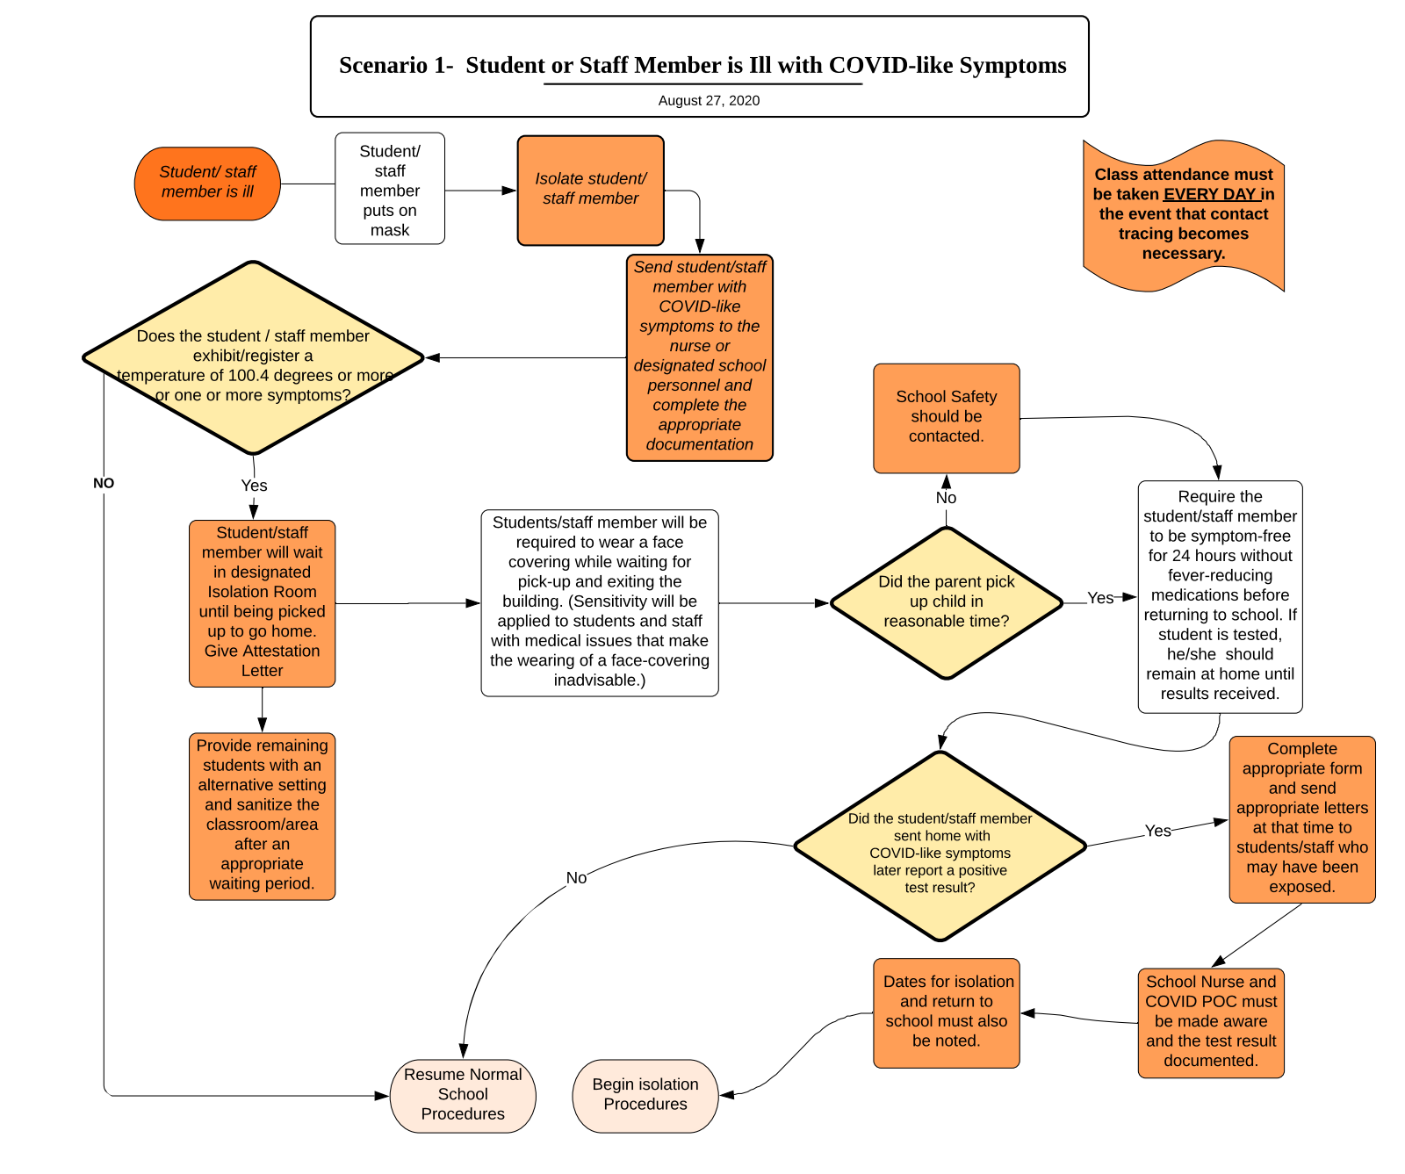
Flow Charts
Notes:
Hillman

Slide 18
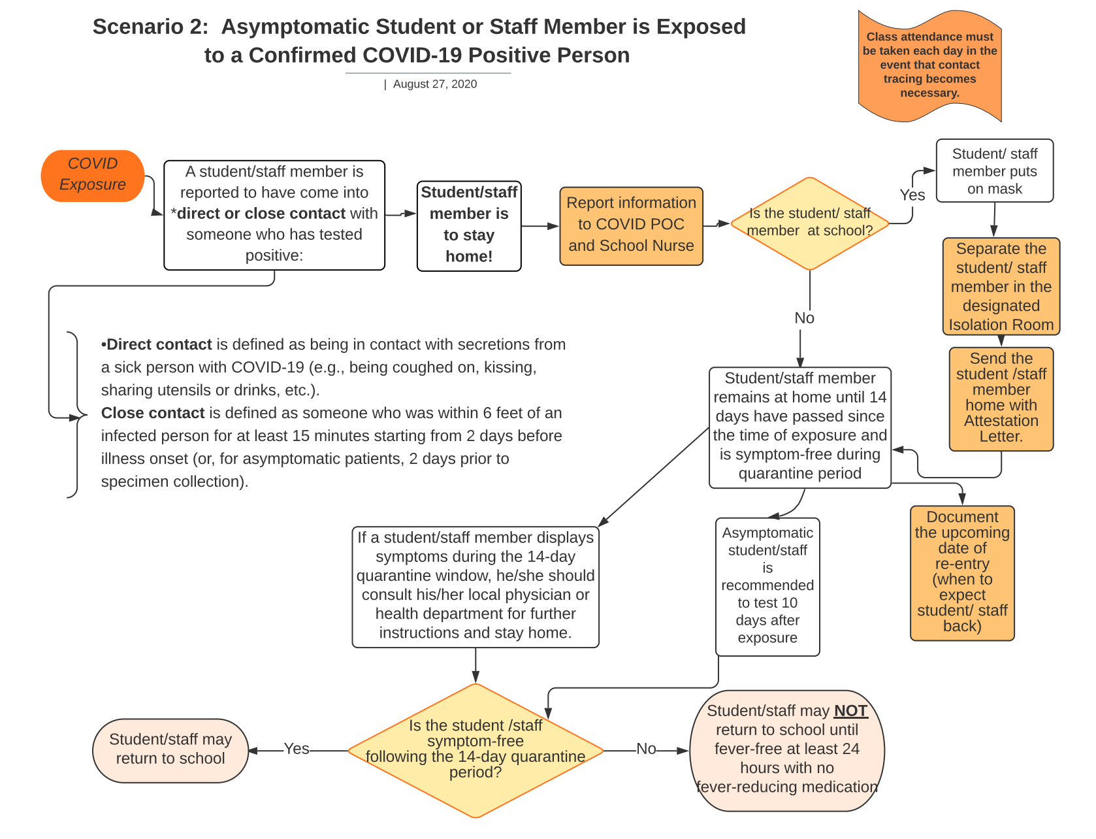
Flow Charts
Notes:
Hillman

Slide 19
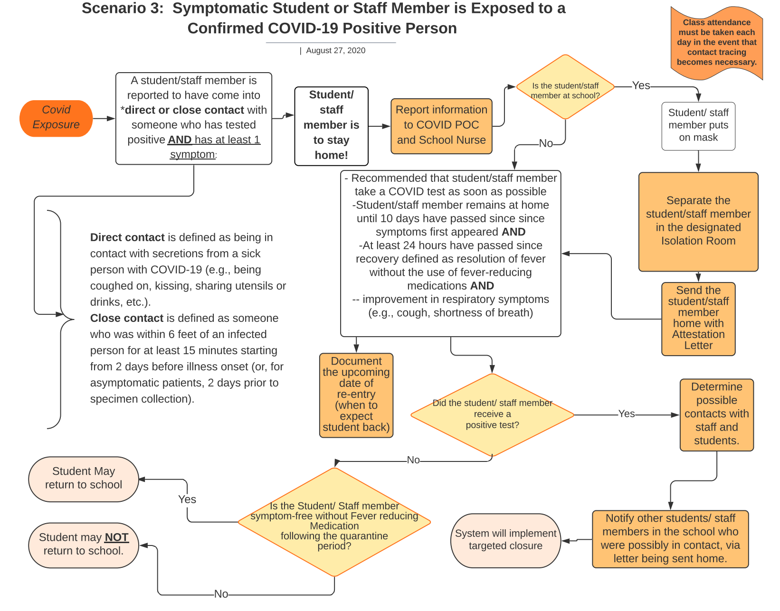
Flow Charts
Notes:
Hillman

Slide 20
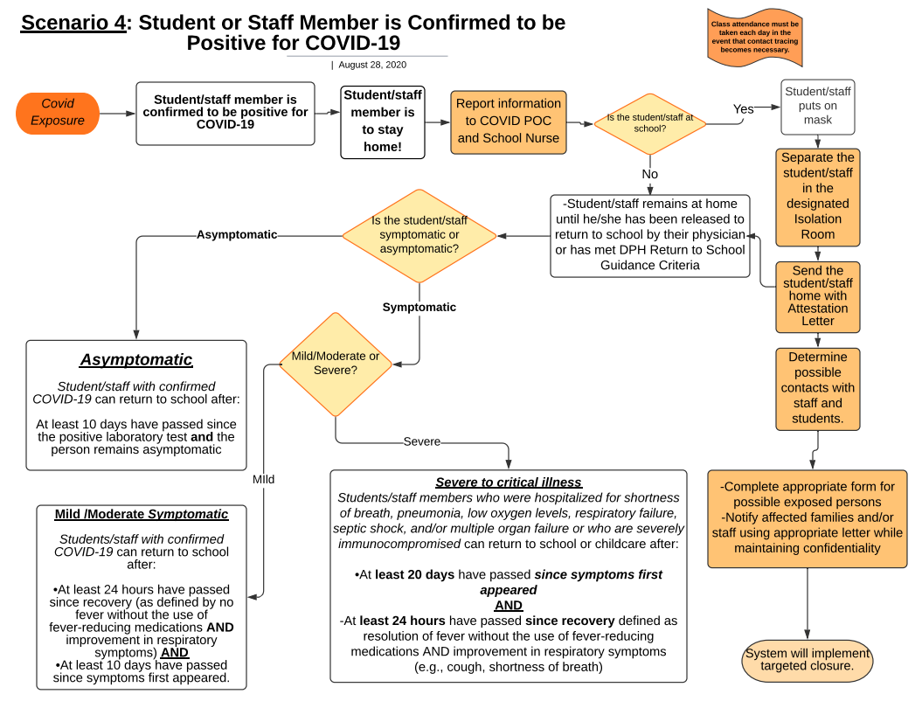
Flow Charts

Slide 21
Letters
Letter to Parents about Exposure to Confirmed Cases:
Identified Close Contact
Identified Not a Close Contact
Close Contacts at School Include:
Being within 6 feet of a sick person with COVID-19 for a total of 15 minutes*; OR,
Being in direct contact with secretions from a sick person with COVID-19 (e.g., being coughed on, kissing, sharing utensils, etc.).
Notes:
Hillman

Slide 22
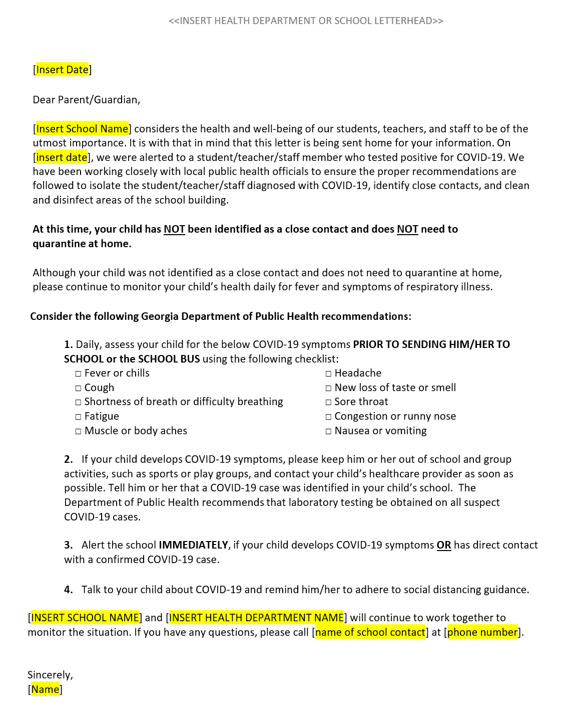
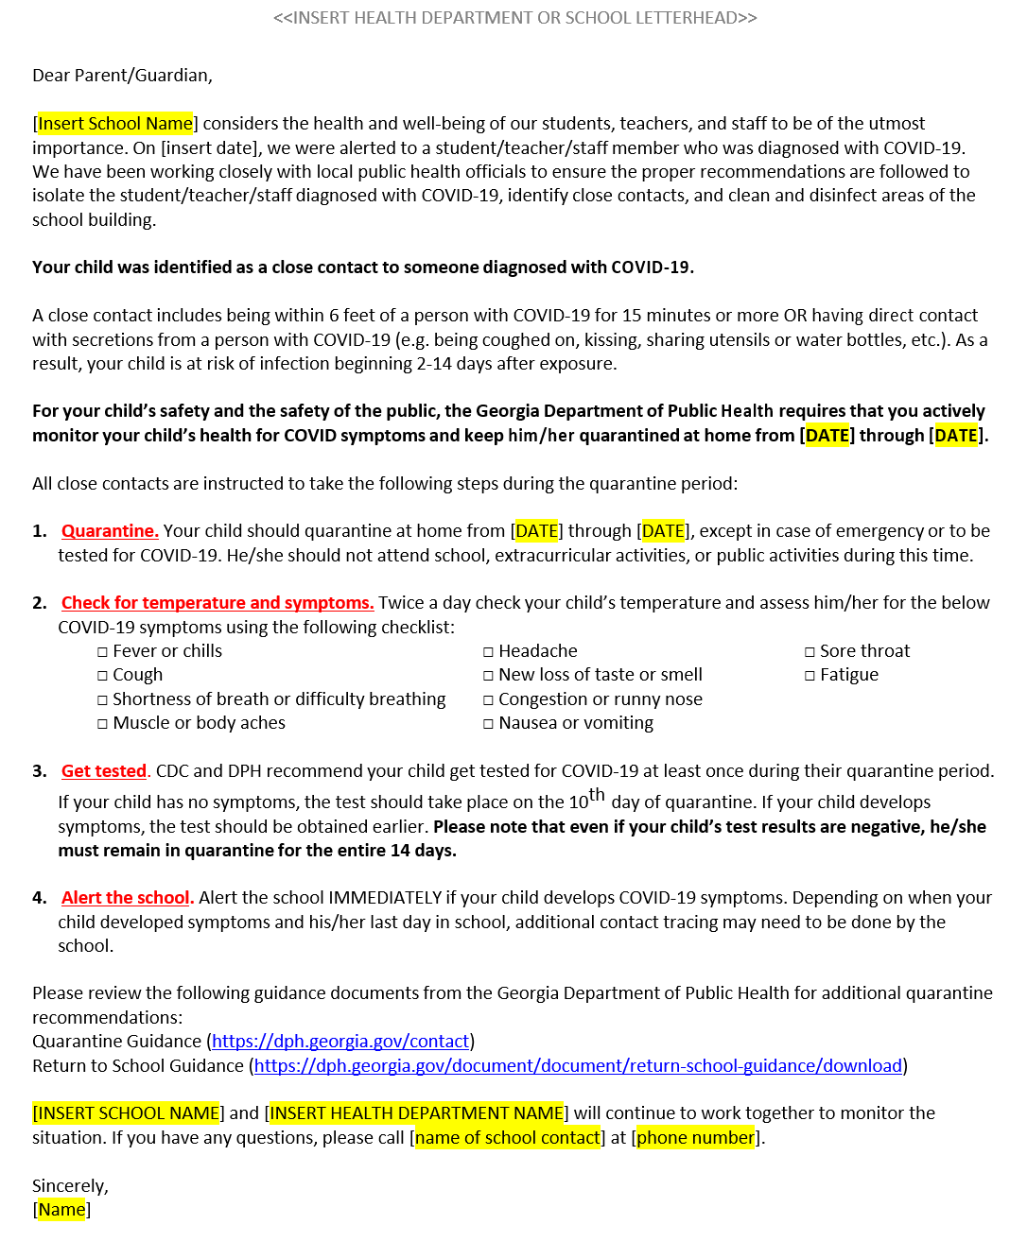
Letters
Notes:
Hillman

Slide 23
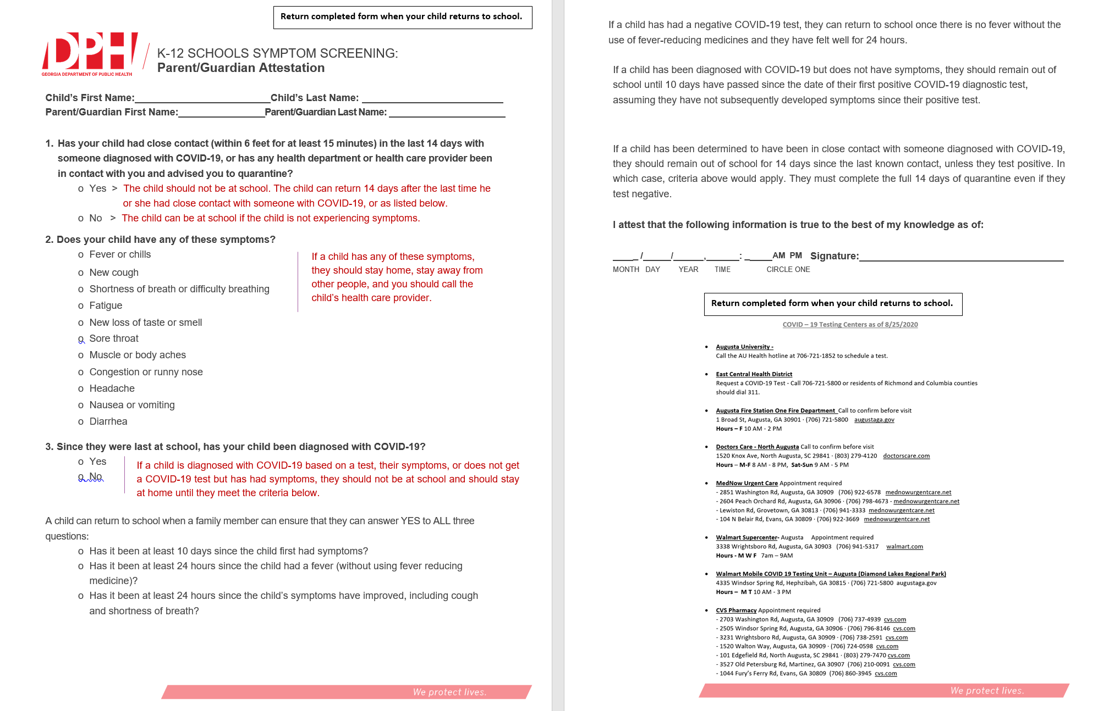
Attestation Form
The RCSS Attestation Form will be given to sick students before they leave school.
Parents will send this
document (signed)
to school when
students return
Notes:
Gloster

Slide 24
Partial/Targeted Closures-Parts of a Building
Partial/Targeted Closure
Temporary (until disinfected)
Positive identified case
Case must be contagious while in the facility [two (2) days before onset of symptoms or two (2) days before the test specimen was collected (if no symptoms)]
Requires DPH notification
Letters sent home (close contact, non-close contact)
Contact tracing
Specific spaces such as classroom, lunchroom, media center, office etc. that infected person occupied for at least 15 minutes
Vacate space
Allow 20 minutes for cleaning and disinfecting
Plan for alternate spaces
Spaces should be cleaned and disinfected as soon as possible
Deep cleaning of room by Custodians
Fog team will come in or school will fog (10 minutes)
Please have a space that can accommodate a class in case you have to close classrooms for cleaning and disenfecting (after a positive diagnosis). Best practice would be to have a few spaces ready.
Notes:
AG

Slide 25
Total School Closures
School Closure
System leadership decision in collaboration with DPH
Some factors to be considered
Absenteeism (approx. 10% of students and/or staff)
Ability of the school to function
High suspected number of cases or greater case rate in educational setting as compared to case rate in the community
Additional indicators that might suggest undiagnosed or unreported COVID-19 like activity among students or staff
Notes:
AG

Slide 26
Reporting to District
District Reporting: Digital Form to be Completed by POC each Wednesday
Notes:
Hillman

Slide 27
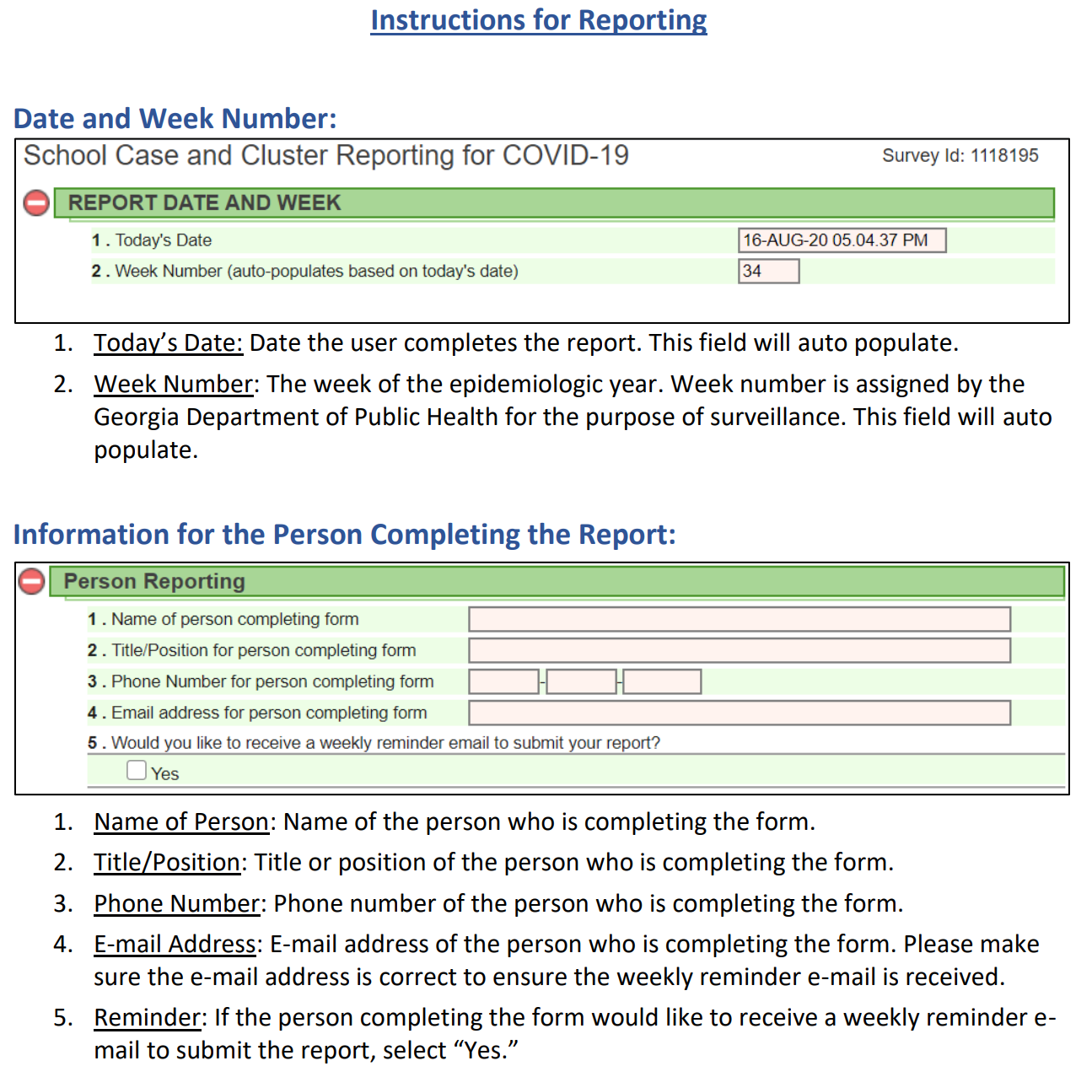
Reporting to State GADOE

Slide 28
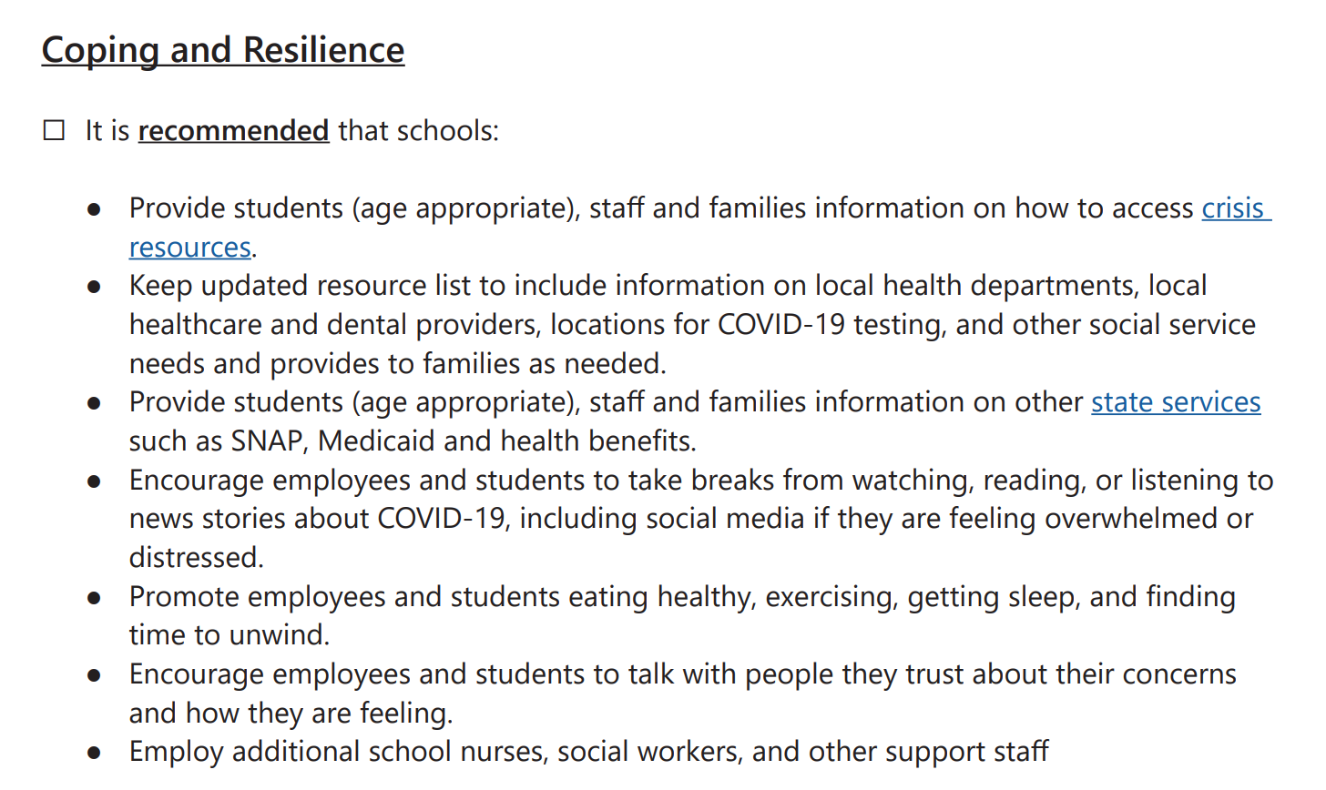
Coping and Resilience
https://www.georgiainsights.com/crisis-contacts.html
Notes:
Hillman

Slide 29
RCSS Path to Recovery
First 5 days of School
Advisement Lessons
Notes:
Hillman

